Slide 1

A Hybrid Approach for Detecting Cyberbullying on Social Media Platform(Twitter) using Machine Learning Algorithms
B415
SRM INSTITUTE OF SCIENCE AND TECHNOLOGY
SCHOOL OF COMPUTING
DEPARTMENT OF COMPUTING TECHNOLOGIES
18CSP109L - MAJOR PROJECT
Guide: Dr. Vegesa S M Srinivasavarma
Research. Asst. Prof., Dept. of CTECH, SRMIST
BATCH ID:B415
GUTTA KOTESWARARAO, RA1911003010621

Slide 2
Table of Contents
S.No | Title
1 | Abstract
2 | Literature Survey
3 | Existing and Proposed Methodology
4 | Problem identification and Description
5 | Requirements(Functional & Non Functional)
6 | System Architecture & Design
7 | Proposed Methodology and Module description
8 | Performance measures/Evaluation
9 | Result & Analysis
10 | Project Demo (Coding)
11 | Journal/Conference paper publication Details
12 | References
13 | Future Enhancements

Slide 3
ABSTRACT
Cyberbullying is growing concern on social media platforms, where users can hide behind anonymity and engage in harmful behavior. Mainly our study, propose a hybrid technique for identifying cyberbullying using various algorithms. We evaluate the performance of 11 different algorithms, including Logistic Regression, MLP Classifier, SGD Classifier, KNN Classifier, Multinomial Naive Bayes, and Bagging Classifier. Our experiments show that Logistic Regression and SGD Classifier achieve the highest accuracy of 90.72% and 90.66% respectively, while Naive Bayes has the lowest accuracy of 56.63%. Our results demonstrate that machine learning algorithms can effectively detect cyberbullying on social media platforms, and our hybrid approach can provide a more comprehensive and accurate solution for identifying and preventing cyberbullying incidents.

Slide 4
Literature Survey
S.No | Title | Authors | Year of Publication | Methodology | Conclusion
1) | Cyber-Bullying Detection in Social Media Platform using Machine Learning | Vaibhav Jain, Ashendra Kumar Saxena, Dr. Athithan Senthil, Abhishek Jain, and Arpit Jain, | 2021-IEEE | Explored various forms for cyber crime and collected data of 35000+ tweets Users can identify the cyberbullying related tweets based on the keywords and populate it in a news feed form. Doing this, it allows users to identify bullies. Used five ML Classifiers, SGD, DTC, Bagging, RF, KNN | Among those five Classifiers they concluded SGD classifier has recorded the Highest accuracy (92.9%) compared to others.

Slide 5
Literature Survey
S.No | Title | Authors | Year of Publication | Methodology | Conclusion
2) | Detection of Hate Tweets using Machine Learning and Deep Learning | Lida Ketsbaia, Biju Issac, Xiaomin Chen | 2020- IEEE | Collected two different datasets of 30,000 and 25,000 tweets from Maryland university and an article Used word embeddings such as Distributed Bag of Words and Distributed Memory Mean and the performance of Word2vec Convolutional Neural Networks (CNNs) to classify online hate. | Linear SVC produced highest accuracy and Bernoulli naïve Bayes produced lowest in data set 1 Continuous bag of words + CNN resulted them an accuracy of 94% and 98.20% of accuracy.

Slide 6
Literature Survey
S.No | Title | Authors | Year of Publication | Methodology | Conclusion
3) | Optimized Twitter Cyberbullying Detection based on Deep Learning | Monirah A. Al-Ajlan, Mourad Ykhlef | 2018- IEEE | In this paper they proposed an optimised twitter cyberbullying detection based on deep learning(OCDD) They used Convolutional neural network for classification Does not extract features from tweets rather represents it a tweet as set of word vectors | Explored new detection techniques OCDD built using training data labelled by human intelligence and word embedding. The resulted set of word embedding was later fed to CNN to detect whether it Bullying or not.

Slide 7
Literature Survey
S.No | Title | Authors | Year of Publication | Methodology | Conclusion
4) | Cyberbullying Detection using Recursive Neural Network through offline Repository | Nidhi Chandra, Sunil Kumar Khatri, Subhranil Som | 2018- IEEE | This paper proposed a prediction method of the user behaviour on his posts on social networking sites specifically twitter tensorflow apis have been used to predict analysis. NLP is applied to break text and CNN for classifying images. | This experiment presents classifying cyberbullying and cyber trolling. Tensorflow contribution library is used to generate the prediction from data set. And converted training and test set into Numpy array

Slide 8
Literature Survey
S.No | Title | Authors | Year of Publication | Methodology | Conclusion
5) | Using Machine Learning to Detect Cyberbullying | K. Reynolds, A. Kontostathis and L. Edwards | 2012- IEEE | Used ML algorithm to detect cyberbullying. For training the data downloaded from website. The data was labeled using a web service. The labelled data, in conjunction with ML techniques provided by the Weka tool kit, to train a computer to recognize bullying content | Used a language-based method of detecting cyberbullying. By recording the percentage of curse and insult words within a post. Attained an accuracy of 78.5%

Slide 9
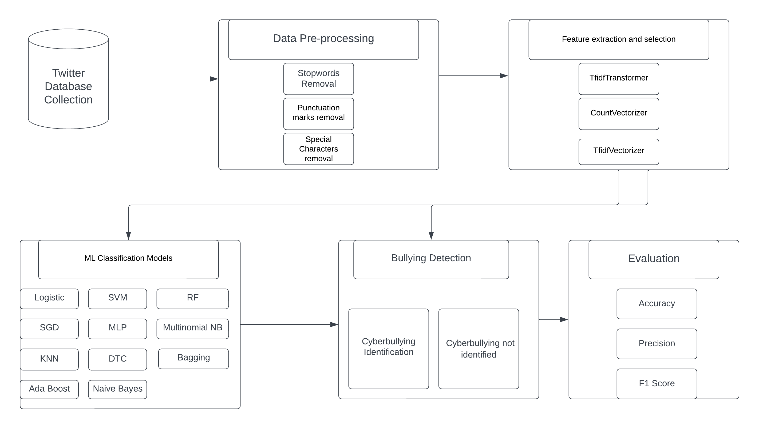
System Architecture
System Architecture Diagram

Slide 10
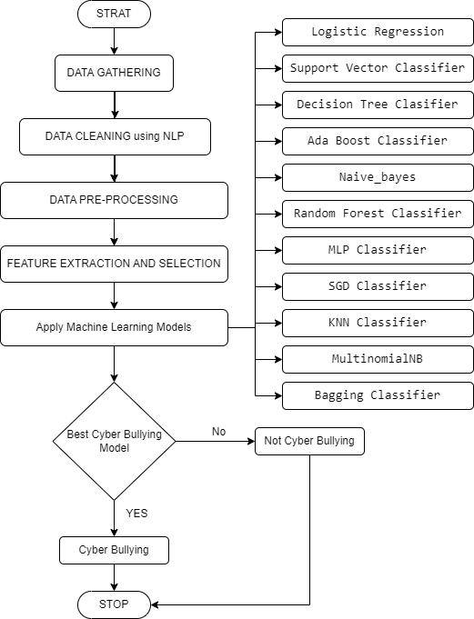
System Architecture
Flow Chart

Slide 11
Existing and Proposed Methodology
Most of the research papers that are published on this problem used limited algorithms in classifying cyberbullying
They focused on image classification in detecting rather than text classification
Our methodology focuses on bullying that undergoes in inner sections of social media platform twitter
Where most of unnoticed cyberbullying takes place in the, comment sections in twitter.
We classify the model using 11 machine learning algorithms
Logistic, SGD, SVM, DTC, Bagging, KNN, RF, ADA boost, MLP, MultinomialNB, Naïve bayes.

Slide 12
Problem Identification and Description
The detection of cyberbullying incidents manually is time-consuming and inefficient.
The problem at hand is to identify the most suitable machine learning algorithm for detecting cyberbullying on Twitter.
The objective is to develop a hybrid approach using ML algorithms to detect instances of cyberbullying on the Twitter platform.
This research contributes to the development of more efficient and reliable methods for detecting.

Slide 13
Requirements (Functional & Non Functional)
Functional:
Data Collection should collect data from Twitter, specifically tweets related to cyberbullying.
Preprocessing the collected data should be preprocessed to remove noise
Feature Extraction the system should extract relevant features from the preprocessed data, such as word frequencies
Algorithm Selection the system should select the best-performing algorithm based on accuracy for cyberbullying detection.
Cyberbullying Detection the selected algorithm should be used to identify instances of cyberbullying.
Visualization the system should provide visualizations and statistics to present the detected cyberbullying instances, such as word clouds, accuracy representation.

Slide 14
Requirements(Functional & Non Functional)
Non Functional:
Performance: The system should have efficient algorithms to handle a large volume of Twitter data and detection of cyberbullying.
Accuracy: The system should achieve a high accuracy rate in detecting cyberbullying instances on Twitter.
Scalability: The system should be scalable to handle an increasing number of tweets and users on Twitter.
Robustness: The system should be resilient to handle variations in data and maintain accuracy across different types of cyberbullying instances.
Privacy and Security: The system should ensure the privacy and security of user data and comply with legal and ethical guidelines for handling sensitive information.

Slide 15
Performance Evaluation
Metrics | LR | SVM | DTC | ADA | RFC | NB
Accuracy | 0.91 | 0.90 | 0.89 | 0.90 | 0.90 | 0.57
Precision | 0.89 | 0.89 | 0.89 | 0.89 | 0.89 | 0.71
Recall | 0.91 | 0.90 | 0.89 | 0.90 | 0.90 | 0.57
F1-Score | 0.90 | 0.89 | 0.89 | 0.89 | 0.89 | 0.62
Figure: Results of LR, SVM, DTC, ADA, NB RFC

Slide 16
Performance Evaluation
Metrics | MLP | SGD | Bagging Classifier | MultinomialNB | KNN
Accuracy | 0.87 | 0.91 | 0.88 | 0.87 | 0.83
Precision | 0.87 | 0.89 | 0.87 | 0.84 | 0.85
Recall | 0.87 | 0.91 | 0.88 | 0.87 | 0.85
F1-Score | 0.87 | 0.90 | 0.85 | 0.85 | 0.84
Figure: Results of MLP,SGD, KNN, MultinomialNB, Bagging

Slide 17
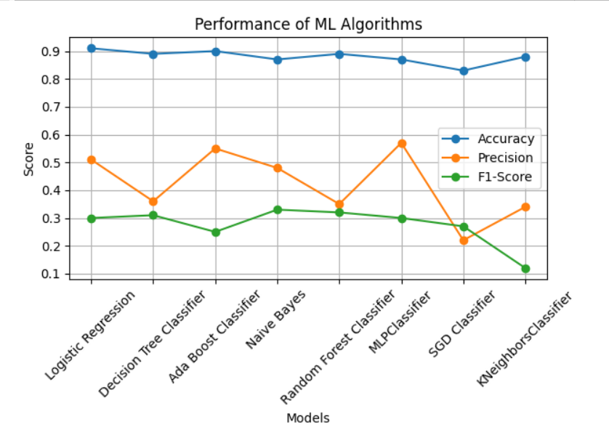
Performance Evaluation
Performance of ML Algorithms

Slide 18
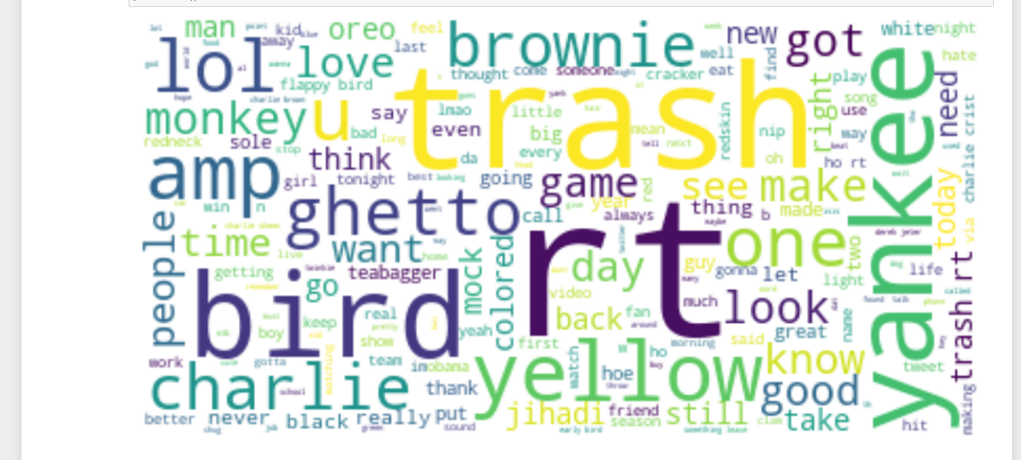
Results and Analysis
Word Visualization of normal language

Slide 19
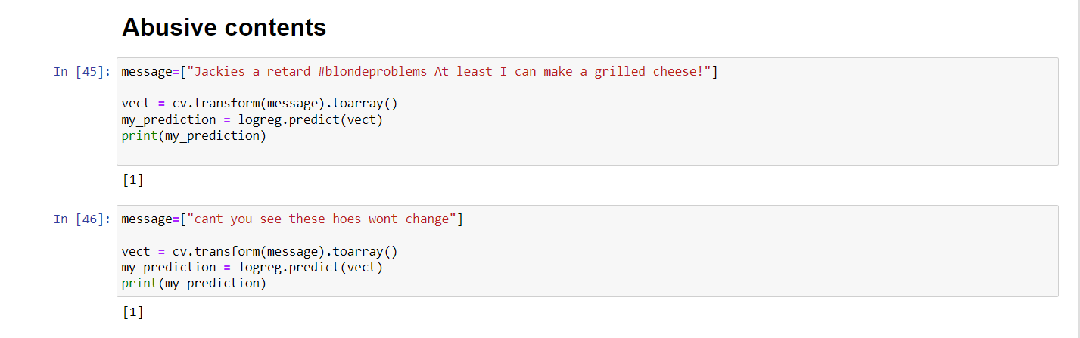
Results and Analysis
Identifying Abusive language as [1]

Slide 20
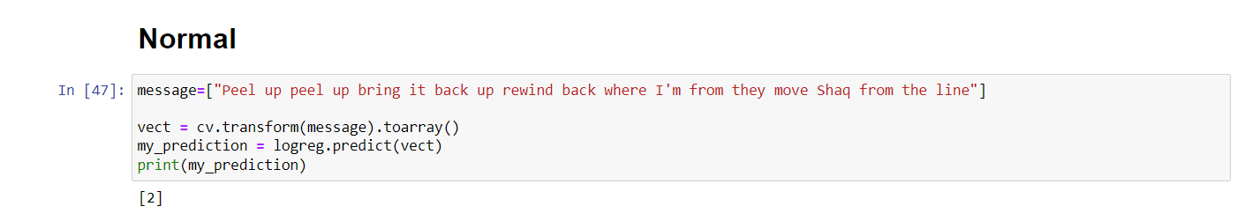
Results and Analysis
Identifying normal language as [2]

Slide 21
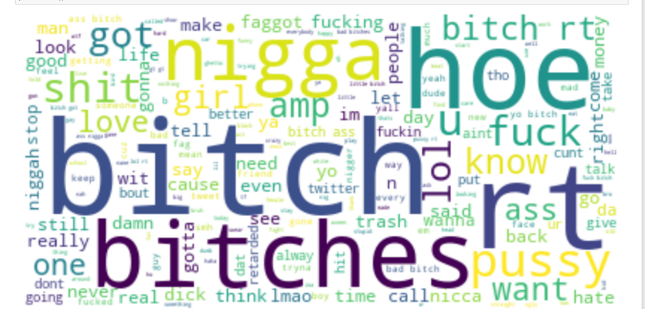
Results and Analysis
Word Visualization of abusive word

Slide 22
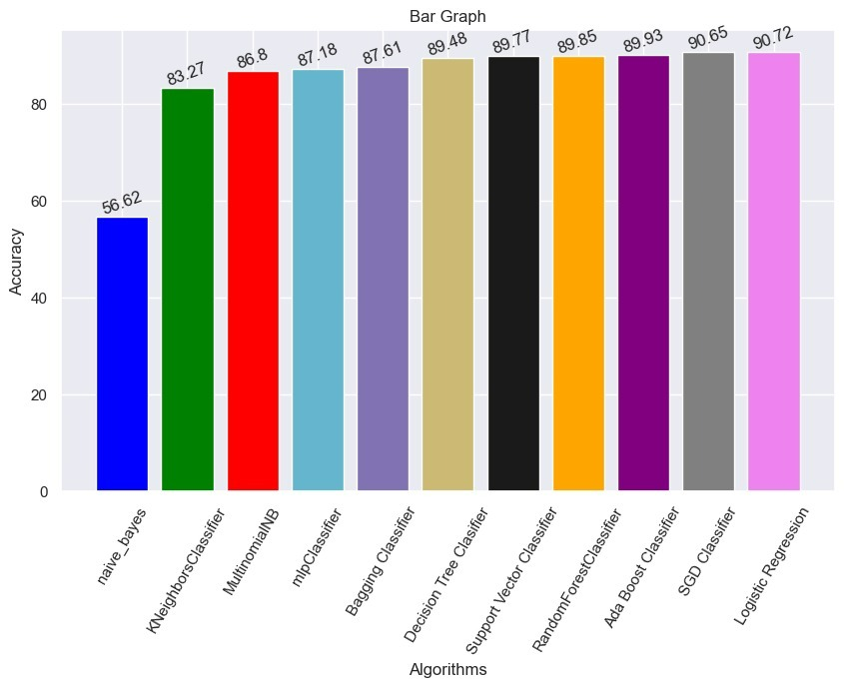
Results and Analysis
Accuracy of all algorithms

Slide 23
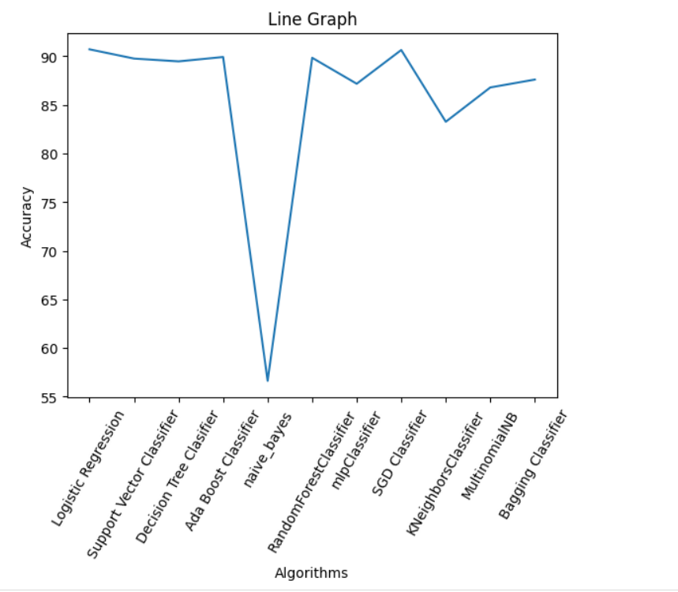
Results and Analysis
Accuracy of all algorithms

Slide 24
Results and Analysis
Based on the results , it can be concluded that the Logistic Regression and SGD Classifier models perform the best for detecting cyberbullying with accuracy scores of 90.72% and 89.77%, respectively.
The Decision Tree Classifier, Ada Boost Classifier, and Random Forest Classifier also performed well, with accuracy scores above 89%.
However, the Naive Bayes model had a significantly lower accuracy score of 56.63%, making it less effective for detecting cyberbullying.
The MLP, SVM, and Bagging had accuracy scores in the mid-to-high 80s, while the KNN and MultinomialNB had the accuracy scores at 83.28% and 86.81%, respectively.

Slide 25
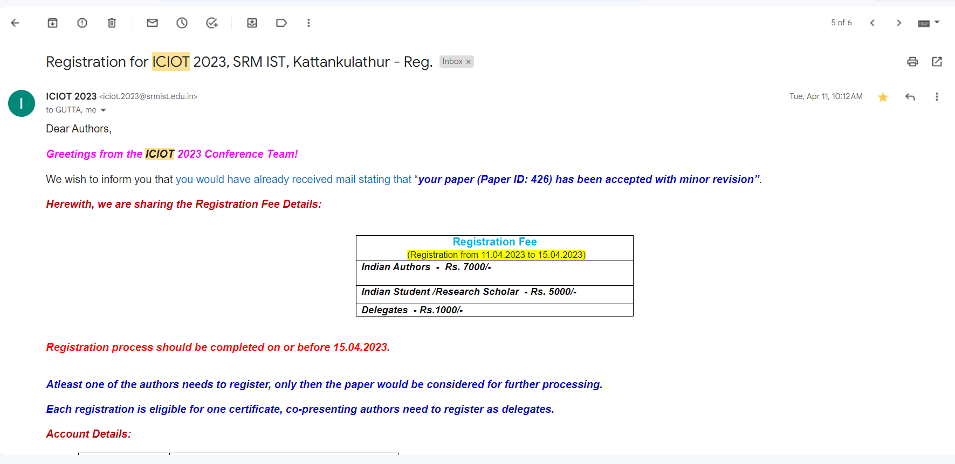
Conference paper publication Details
ICIOT 2023 Paper acceptance

Slide 26
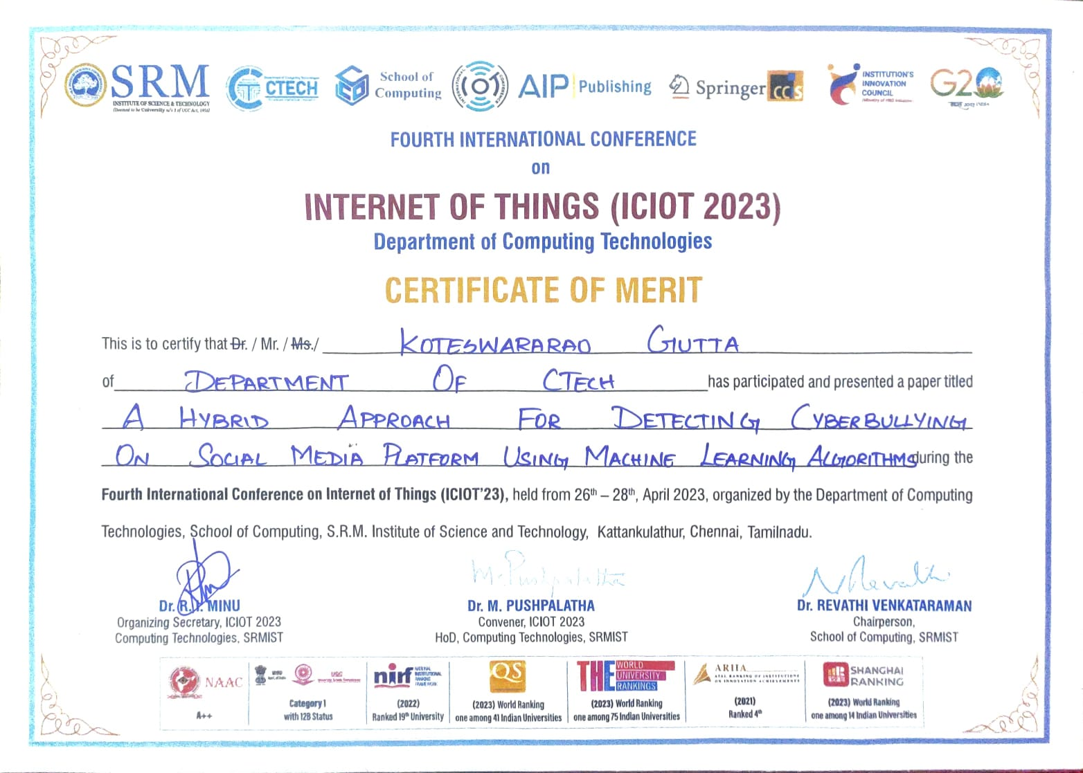
Conference paper publication Details
ICIOT 2023 Certificate

Slide 27
References
Lida Ketsbaia, Biju Issac and Xiaomin Chen, “Detection of Hate Tweets using Machine Learning and Deep Learning,” in Proc. of the 19th IEEE International conference on Trust, Security and Privacy in Computing and Communications, Guangzhou, China, pp. 751-758, 2020.
Vaibhav Jain, Ashendra Kumar Saxena, Dr. Athithan Senthil, Abhishek Jain, and Arpit Jain, “Cyber-Bullying Detection in Social Media Platform using Machine Learning” in Proc. of the 10th International Conference on System Modeling & Advancement in Research Trends (SMART), Morabad, India, pp. 401-405, 2021.
Monirah A. Al-Ajlan, and Mourad Ykhlef, “Optimized Twitter Cyberbullying Detection based on Deep Learning,” in Proc. of the 21st Saudi Computer Society National Computer Conference (NCC), Riyadh, Saudi Arabia, pp. 1-5, 2018.
Jaideep Yadav, Devesh Kumar, and Dheeraj Chauhan, “Cyberbullying Detection using Pre-Trained BERT Model,” in Proc. of the International Conference on Electronics and Sustainable Communication Systems (ICESC), Coimbatore, India, pp. 1096-1100, 2020.
Nidhi Chandra, Sunil Kumar Khatri, and Subhranil Som, “Cyberbullying Detection using Recursive Neral Network through offline Repository,” in Proc. of the 7th International Conference on Reliability, Infocom Technologies and Optimization (Trends and Future Directions) (ICRITO), Noida, India, pp. 748-754, 2018.

Slide 28
References
Samghabadi, Niloofar Safi, et al. ”Detecting nastiness in social media.” Proceedings of the First Workshop on Abusive Language Online. 2017.
R. R. Dalvi, S. Baliram Chavan and A. Halbe, Detecting A Twitter Cyberbullying Using Machine Learning, ICICCS, pp. 297-301, doi: 10.1109/ICICCS48265.2020.9120893. (2020)
N. Silva, D. L. Hall, C. Rich, BullyBlocker: toward an interdisciplinary approach to identify cyberbullying. Social Network Analysis and Mining. 8 (2018), doi:10.1007/s13278-018-0496-z
Burnap, P. and M.L. Williams, Us and them: identifying cyber hate on Twitter across multiple protected characteristics. EPJ Data Science, 2016. 5(1): p. 11.
Gitari, N.D., et al., A lexicon-based approach for hate speech detection. International Journal of Multimedia and Ubiquitous Engineering, 2015. 10(4): p. 215-230.
Tulkens, S., et al., A dictionary-based approach to racism detection in dutch social media. arXiv preprint arXiv:1608.08738, 2016.

Slide 29
References
Jain, A., Gahlot, A. K., Dwivedi, R., Kumar, A., & Sharma, S. K. (2018). Fat Tree NoC Design and Synthesis. In Intelligent Communication, Control and Devices (pp. 1749-1756). Springer, Singapore.
Kumar, Sandeep, E. G. Rajan, and Shilpa Rani. “A Study on Vehicle Detection through Aerial Images: Various Challenges, Issues and Applications.” In 2021 International Conference on Computing, Communication, and Intelligent Systems (ICCCIS), pp. 504-509. IEEE, 2021
Dinakar, K., R. Reichart, and H. Lieberman. Modeling the detection of textual cyberbullying. In fifth international AAAI conference on weblogs and social media. 2011.
Liu, S. and T. Forss. Combining N-gram based Similarity Analysis with Sentiment Analysis in Web Content Classification. in KDIR. 2014.
S. Salawu, Y. He and J. Lumsden, "Approaches to Automated Detection of Cyberbullying: A Survey," in IEEE Transactions on Affective Computing, vol. 11, no. 1, pp. 3-24, 1 Jan.-March 2020, doi: 10.1109/TAFFC.2017.2761757.

Slide 30
Thank You

